Slide 1
DIGITAL ELECTRONICS
Number System:
A number system is defined as a system of writing to express numbers. A number system is a mathematical system with base n, where n represents total numbers present in that system.
Eg: In decimal number system, the number of digits is 10
Decimal number system (0,1,2,3,4,5,6,7,8,9,10,11,12,13,14,15)
Binary number systems (0,1)
Octal number system (0,1,2,3,4,5,6,7,10,11,12,13,14,15,16,17)
Hexa-decimal number system (0,1,2,3,4,5,6,7,8,9,A,B,C,D,E,F)
Radix Point:
Radix point is a base point used to separate the integer part and the fractional part of a number. 1.2 1 interger
2 fraction11.011
Base or radix:
The number of symbols used in a number system is called base or radix of the number system. Eg: In decimal number system – Base is 10
In Binary number system – Base is 2
In Hexadecimal number system – Base is 16 etc.22

Slide 2
Most significant bit (MSB):The left most bit of a binary number which has the highest place value is called most significant bit.
Least significant bit (LSB):The right most bit of a binary number which has the least place value is called least significant bit.
Bit:A binary digit is called a bit. Example: 0 or 1
Nibble: A group of four bits is called a Nibble. Example: 0110, 1110 etc.
Byte: A group of eight bits is called a byte. Example: 01101101, 11010011 etc.
1111011
MSB LSB

Slide 3
Types of number systems
Binary number system
Octal number system
Decimal number system
Hexadecimal number system
Binary number system:
The base of binary number system is 2. The digits used are 0 and 1.
Example: 11001(2), 0101(2)
Octal number system:
The base of octal number system is 8.
The digits used are 0, 1, 2, 3, 4, 5, 6 and 7.
Example: 157(8), 2312(8), 110(8)

Slide 4
Table representing decimal, Octal and binary number
Decimal Number | Octal Number | Binary Number
0 | 0 | 000
1 | 1 | 001
2 | 2 | 010
3 | 3 | 011
4 | 4 | 100
5 | 5 | 101
6 | 6 | 110
7 | 7 | 111

Slide 5
Decimal number system:
The base of decimal number system is 10.
The digits used are 0, 1, 2, 3, 4, 5, 6, 7, 8 and 9.
Example: 0157(10), 6587(10), 0110(10)
Hexadecimal number system:
The base of hexadecimal number system is 16.
The digits used are 0, 1, 2, 3, 4, 5, 6, 7, 8 9, A, B, C, D, E and F.
Example: 0157(16), 2312(16), 0110(16), ABC5(16), BDEF(16)

Slide 6
Table representing decimal, hexadecimal and binary number
Decimal Number | Hexadecimal Number | Binary Number
0 | 0 | 0000
1 | 1 | 0001
2 | 2 | 0010
3 | 3 | 0011
4 | 4 | 0100
5 | 5 | 0101
6 | 6 | 0110
7 | 7 | 0111
8 | 8 | 1000
9 | 9 | 1001
10 | A | 1010
11 | B | 1011
12 | C | 1100
13 | D | 1101
14 | E | 1110
15 | F | 1111

Slide 7
HOW TO CONVERT DECIMALS NUMBER SYSTEM TO BINARY
if we have a number like 52 we can convert it to binary
52₁₀ To K₂
52 ÷ 2 =26 rem 0 LSB
26 ÷ 2 =13 rem 0
13 ÷ 2 = 6 rem 1 K = 110100
6 ÷ 2= 3 rem 0
3 ÷ 2 =1 rem 1
1 ÷ 2 =0 rem 1 MSB

Slide 8
Example 2
if we have a number like 67 we can convert it to binary
67₁₀ To K₂
67 ÷ 2 =33 rem 1 LSB
33 ÷ 2 = 16 rem 1
16 ÷ 2 = 8 rem 0 K =1000011
8 ÷ 2= 4 rem 0
4 ÷ 2 =2 rem 0
2 ÷ 2 =1 rem 0
1 ÷ 2 = 0 rem 1 MSB

Slide 9
Example 3
if we have a number like 71 we can convert it to binary
71₁₀ To K₂
71 ÷ 2 =35 rem 1 LSB
35 ÷ 2 =17 rem 1
17 ÷ 2 = 8 rem 1 K = 1000111
8 ÷ 2= 4 rem 0
4 ÷ 2 = 2 rem 0
2 ÷ 2 =1 rem 0
1 ÷ 2 =0 rem 1 MSB

Slide 10
Conversion of binary to decimal number system
1101111
64 + 32 + 8 + 4 + 2 + 1 = 111
1 | 1 | 0 | 1 | 1 | 1 | 1
2⁶ | 2⁵ | 2⁴ | 2³ | 2² | 2¹ | 2⁰
64 | 32 | 16 | 8 | 4 | 2 | 1

Slide 11
Lets do the confirmation
if we have a number like 111 we can convert it to binary
111₁₀ To K₂
111 ÷ 2 =55 rem 1 LSB
55÷ 2 =27 rem 1
27 ÷ 2 = 13 rem 1 K = 1101111
13 ÷ 2 = 6 rem 1
6 ÷ 2 = 3 rem 0
3 ÷ 2 =1 rem 1
1 ÷ 2 =0 rem 1 MSB

Slide 12
Conversion of binary to decimal number system (example 2)
1001011
64 + 8 +2 +1 = 75
1 | 0 | 0 | 1 | 0 | 1 | 1
2⁶ | 2⁵ | 2⁴ | 2³ | 2² | 2¹ | 2⁰
64 | 32 | 16 | 8 | 4 | 2 | 1

Slide 13
Lets do the confirmation
if we have a number like 75 we can convert it to binary
75₁₀ To K₂
75 ÷ 2 =37 rem 1 LSB
37÷ 2 =18 rem 1
18 ÷ 2 = 9 rem 0 K = 1001011
9 ÷ 2 = 4 rem 1
4 ÷ 2 = 2 rem 0
2 ÷ 2 =1 rem 0
1 ÷ 2 =0 rem 1 MSB

Slide 14
Binary Arithmetic
Binary arithmetic includes the basic arithmetic operations
Addition
Subtraction
Multiplication
division
Binary Addition: The rules to perform binary addition are
0 + 0 = 0
0 + 1 = 1
1 + 0 = 1
1 + 1 = 0 with a carry 1

Slide 15
Binary Subtraction: The rules to perform binary subtraction are
0 – 0 = 0
0 – 1 = 1 with a borrow 1
1 – 0 = 1
1 – 1 = 0
Binary Multiplication: The rules to perform binary multiplication are
0 X 0 = 0
0 X 1 = 0
1 X 0 = 0
1 X 1 = 1
Binary Division: The rules to perform binary division are
÷ 0 = not defined
0 ÷ 1 = 0
÷ 0 = not defined
1 ÷ 1 = 1

Slide 16
1’s Complement of binary numbers:
The 1’s complement of a binary number is obtained by changing each 0 to 1 and 1 to 0. Eg: The 1’s complement of (101101)2 is (010010)2
2’S Complement of binary numbers: The 2’S complement of a binary number is obtained by adding 1 to the 1’s complement of the number.
Eg: The 2’s complement of (101101)2 is (010010)2 + 1 = (010011)2
Note: The 1’S complement and the 2’S complement of a binary number help to do the subtraction by the method of addition.

Slide 17
BINARY CODES
Digital Codes or Binary Codes:
A group of binary digits is known as a binary code or a digital code.
Numeric Code:
Digital code represented by the number is known as a numeric code.
Classification:
The codes are broadly classified into
Weighted code
Non-weighted code
Reflective code
Sequential code
Error detecting and correcting codes

Slide 18
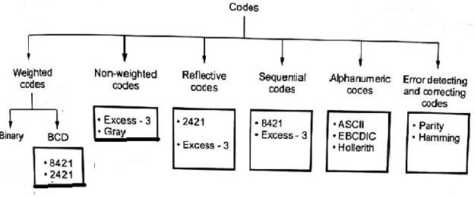

Slide 19
Weighted codes:
The weighted codes are those where the position of each number represent a specific weight. In these codes each decimal digit is represented by a group of four bits.
In weighted codes, each digit is assigned a specific weight according to its position. For example, in 8421/BCD code, 1001 the weights of 1, 1, 0, 1 (from left to right) are 8, 4, 2 and 1 respectively.
Examples:8421, 2421.

Slide 20
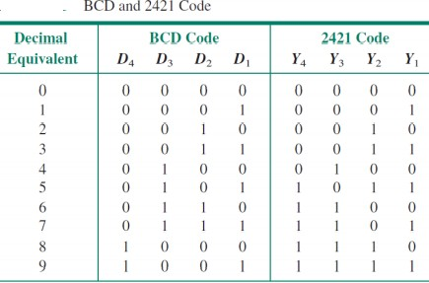

Slide 21
The non-weighted codes are not positionally weighted. In other words, codes that are not assigned with any weight to each digit position.
Non-weighted codes:
Example: Excess-3(XS-3) and Gray Codes.
Excess-3 code
Excess-3 codes are Non-weighted and can be obtained by adding 3 to each decimal digit then it can be represented by using 4 bit binary number for each digit. An Excess-3 equivalent of a given binary number is obtained using the following steps:
Find the decimal equivalent of the given binary number.
Add +3 to each digit of decimal number.

Slide 22
Convert the newly obtained decimal number back to binary number to get required excess-3 equivalent. These are following excess-3 codes for decimal digits –
Decimal | BCD 8421 | Excess – 3 code BCD + 0011
0 | 0000 | 0011
1 | 0001 | 0100
2 | 0010 | 0101
3 | 0011 | 0110
4 | 0100 | 0111
5 | 0101 | 1000
6 | 0110 | 1001
7 | 0111 | 1010
8 | 1000 | 1011
9 | 1001 | 1100

Slide 23
Gray code:
Gray code is non weighted code, which means there is no specific weight assigned to the bit position.
Applications:
It is used in analog to digital conversion, input / output devices.
It is used to reduce errors that occur in data transmission.
Binary to gray code conversion
The MSB of the gray code is the MSB of the binary number.
Perform XOR operation between the MSB and the second significant bit of the binary number.
XOR the second and third significant bits of the binary, the result is the third significant bit of the gray code.
Repeat the process till the end of the LSB of the binary number

Slide 24
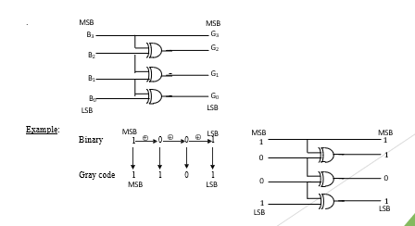

Slide 25
Gray code to binary conversion
The MSB of the binary is same as the MSB of gray code.
Perform the XOR operation between the MSB of the binary and the second significant bit of gray code the result is the second significant bit of binary.
Perform the XOR operation between the second significant bit of binary and the third significant bit of gray code the result is the third significant bit of binary.
Repeat the process until all the gray code bits are XOR.

Slide 26
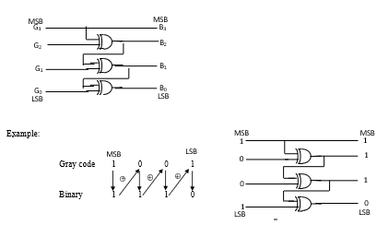
Circuit diagram of gray code to binary conversion

Slide 27
Reflective codes:
A code is said to be reflective when the code for 9 is the complement for the code 0, 8 for 1, 7 for 2, 6 for 3 and 5 for 4.
Eg: 2421 code and Excess-3 code
Decimal digit | 2 | 4 | 2 | 1
0 | 0 | 0 | 0 | 0
1 | 0 | 0 | 0 | 1
2 | 0 | 0 | 1 | 0
3 | 0 | 0 | 1 | 1
4 | 0 | 1 | 0 | 0
5 | 1 | 0 | 1 | 0
6 | 1 | 1 | 0 | 0
7 | 1 | 1 | 0 | 1
8 | 1 | 1 | 1 | 0
9 | 1 | 1 | 1 | 1

Slide 28
Sequential codes:
A code is said to be sequential when each succeeding code is binary number greater than its preceding code.
Eg: 8421 code and Excess-3 code
Parity codes:
The parity code is used for the purpose of detecting errors during the transmission of binary information. The parity code is a bit that is included with the binary data to be transmitted.
The inclusion of a parity bit will make the number of 1’s either odd or even. Based on the number of 1’s in the transmitted data, the parity code is of two types.
Even parity code
Odd parity code
Even parity code:
If the total number of 1 bits in the word including parity bit is Even, then such a parity code is said to be Even parity code.
Odd parity code:
If the total number of 1 bits in the word including parity bit is odd, then such a parity code is said to be
odd parity code.

Slide 29
The following table shows the even and odd parity bits for 4 bit data word
Data | Even parity | Odd parity
0 0 0 0 | 0 | 0
0 0 0 1 | 1 | 0
0 0 1 0 | 1 | 0
0 0 1 1 | 0 | 1
0 1 0 0 | 1 | 0
0 1 0 1 | 0 | 1
0 1 1 0 | 0 | 1
0 1 1 1 | 1 | 0
1 0 0 0 | 1 | 0
1 0 0 1 | 0 | 1
The simple parity will not detect two errors within the same word. To detect and correct error in the word Hamming code is used.

Slide 30
Hamming code:
Hamming code is a set of error-correction codes that can be used to detect and correct the errors that can occur when the data is moved or stored from the sender to the receiver. It is technique developed by R.W. Hamming for error correction.
Selecting the number of parity bits:
The number of parity bits to be chosen depends on word length.
Let n be the number of information or data bits, then the number of parity bits P is determined from the following formula,
2^{P} ≥ n + P + 1
Example:
If 4-bit information is to be transmitted, then n=4. The number of parity bits is determined by the trial and error method
Let P=2, we get,
2² ≥ 4 + 2+ 1
The above equation implies 4 not greater than or equal to 7. So let’s choose another value of P=3.
2³ ≥ 4 + 3+ 1
Now, the equation satisfies the condition. So number of parity bits, P=3. The bit designation is

Slide 31
D7 | D6 | D5 | P3 | D1 | P2 | P1
Problem:
Data bits 1011 must be transmitted. Construct the even parity, seven bit Hamming code for this data
D7 | D6 | D5 | P3 | D1 | P2 | P1
1 | 0 | 1 |  | 1
P1 checks for even parity of bit positions 1,3,5 and 7. For even parity P1 must be 1
D4 | D3 | D2 | P3 | D1 | P2 | P1
1 | 0 | 1 |  | 1 |  | 1
P2 checks for even parity of bit positions 2,3,6 and 7. For even parity P2 must be 0
D4 | D3 | D2 | P3 | D1 | P2 | P1
1 | 0 | 1 |  | 1 | 0 | 1
P3 checks for even parity of bit positions 4,5,6 and 7. For even parity P3 must be 0
D4 | D3 | D2 | P3 | D1 | P2 | P1
1 | 0 | 1 | 0 | 1 | 0 | 1

Slide 32
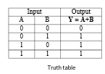

LOGIC GATES
Logic gate is an electronic circuit that performs a Boolean logical operation. A logic gate has one or more inputs but only one output.
The basic gates are AND gate, OR gate and NOT gate.
The universal gates are NAND gate and NOR gate.
The special gates are XOR and XNOR.
OR gate:
OR gate is a basic gate which has two or more input but only
one output. The output is high if any one of the input is high.

Slide 33


AND gate:
AND gate is a basic gate which has two or more input but only one output. The output is
high if all the inputs are high.
NOT gate:
It is a basic gate which complements the input signal value. It is also called as an inverter. It is a logic gate with only one input and one output.

Slide 34
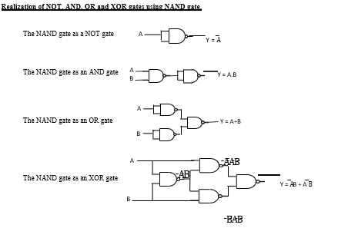

Slide 35
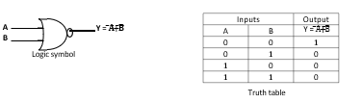

NOR gate:
NOR gate is a universal gate which performs complement of OR logic. NOR gate has two or more input but only one output. The output is high if and only if all the inputs are low.
Exclusive OR (XOR) gate:
XOR gate is a special gate which has two or more input but only one output. The output is high only when odd numbers of input are high.
XOR gate is also called as Inequality detector.

Slide 36
Realization of NOT, AND, OR and XNOR gates using NOR gate.
The NOR gate as a NOT gate
A
Y = A̅
The NOR gate as a OR gate
A
Y = A+B
B
The NOR gate as a AND gate
A
Y = A.B
B
A
The NOR gate as a XNOR gate
Y = AB + A̅ B̅
B
Simplification of Boolean expressions
Product term: The logical product of Boolean variables, complemented or uncomplemented form is a product term.
Example: A B̅ C, A B C, A B C̅, A B, A̅ B̅ etc
Sum term: The logical sum of Boolean variables, complemented or uncomplemented form is a sum term.
Example: ( A + B̅ + C), (A + B), ( A̅ + B̅ + C)
Sum of products (SOP): The logical sum of two or more logical product terms is known as sum of products.
Example: A B̅ + C̅ A + A B
Product of sum (POS): The logical product of two or more logical sum terms is known as product of sum.
Example: (A + B̅) (B + C) (A + B)
Canonical SOP (or) Standard SOP expression: The Boolean expression containing all the input variables in each of the product term either in complemented or uncomplemented form is known as canonical SOP expression.
Canonical POS (or) Standard POS expression: The Boolean expression containing all the input variables in each of the sum term either in complemented or uncomplemented form is known as canonical POS expression.

